Slide 1
Salesforce Practitioners
GM Financial
May, 2024

Slide 2
#1 Practitioners for Lending Application

Slide 3
Asalatha Channamallu, Integration Specialist (Salesforce, iPaaS)
asa.channamallu@brillio.com
Dallas, Texas
Industry Experience:
High-Tech, Finance and Commercial
Professional Summary
20+ years of experience in IT industry playing the role of a Technical Architect, COE Lead for integrations
Seasoned experienced Integration Specialist and delivered large complex enterprise level end-to-end integration solution in Salesforce eco-system. She is recognized leader in integration space.
Prior Experiences → Worked as Engineering Director at Standav → Worked as a Technical Architect at LiquidHub (currently Capgemini)
Relevant Project Experience
Client: McAfee, Integration Architect
Led design and discovery for the McAfee’s FDT project which involved setting up their MDM Strategy, Event driven integration architecture for their B2B Partner portal.
As integration Architect responsible for defining the integrations strategy
Responsible for providing integration solution for B2B integrations
Responsible for setting up MDM Strategy with practices
Responsible for overall integration development and delivery along with release management
Client: DoorDash, Integration Architect
Designed and developed APIs to support HR processes with in DoorDash organization. Supported integrations of systems like Workday, Charles Schwab, Pactsafe, Google Drive and NetSuite using Mulesoft. Responsible for designing the API’s and implementing in Mulesoft
Worked closely with various stake holders to understand requirements and limitations of the systems that needs to be integrated.
Responsible for producing architectural documents.
Supported existing Mulesoft applications by providing production support, implementing enhancements and bug fixes.
Integrated various end systems like Pactsafe, Google Drive, Workday and NetSuite with MuleSoft Anypoint Platform.
Developed RESTful Services in Mule ESB based on SOA Architecture.
Implemented Security mechanisms like Encryption, Decryption the passwords, Client ID Enforcement, CORS Policy, OAuth Authentication & Authorization using Access Token.
Involved in configuration and release management process on CloudHub using Jenkins, Maven, Git.
Core Skill Sets
Integration Architect, experience in MuleSoft, Boomi, IBM MQ, Kafka, Workato and custom integration development using Spring/Java
Expertise in Lead-to-Revenue & CPQ integrations with ERP systems like SAP, Workday, NetSuite
Extensive experience in delivering integrations with complex B2B Commerce and SaaS applications
Extensive experience on data engineering and data lake implementations using cloud stack (Azure)
Experience with data integration using tools like Talend, Airflow and custom ETL implementations
Certifications
Certified MuleSoft Professional
Certified Java Professional
Recent Roles
Solution Architect
Integration and Salesforce Lead
Integration CoE Leader
Key Clients
McAfee
DoorDash
EmeraldX
Ecolab
Toast
Ciena
Zendesk

Slide 4
Asalatha Channamallu, Integration Specialist (Salesforce, iPaaS)
Client: EmeraldX, Integration Architect
Designed and delivered integrations for CPQ with systems like Salesforce, NetSuite and databases.
As integration Architect responsible for defining the integrations strategy, APIs portal & Discovery, CI/CD setup etc..
Responsible for setting up MuleSoft integration platform, defining the security strategies and best practices
Responsible for overall integration development and delivery along with release management
Client: Ecolab Inc., Integration Architect
Designed and developed APIs for Supply Chain Integration to provide real time order status (Mobile App-Self Service), Tracking (Web App) and customer service by integrating SAP, Salesforce, SQL Server and Logistics aggregator 4KITES.
Led the team responsible for creating Microservices based application
Led the discovery & design sessions for Business requirements gathering, analysis and client interviews.
Responsible Designing data integration flow to store data in the customer domain and document the design for development.
Developed APIS integrating SAP and 4KITES processing IDOCS, transform and send the information to 4Kites aggregator.
Developed Order Status API consuming SAP BAPI, Order Status Mobile and Web APP and customer service APP in Salesforce.
Integrated various end systems like SAP, SQL Server and other vendors applications such as 4kites with MuleSoft Anypoint Platform.
Worked with Data Modeling team to design the data service APIs to store the logistics shipping information n SQL server.
Developed RESTful Services in Mule ESB based on Microservice Architecture.
Worked with Data Modeling team to design the data service APIs to store the logistics shipping information in SQL server.
Implemented Security mechanisms like Encryption, Decryption the passwords, Client ID Enforcement, CORS Policy, OAuth Authentication & Authorization using Access Token.
Worked closely with SAP Team in building integrations with SAP Enterprise services through SAP Adapter nodes and web services.
Responsible for setting up release management process on CloudHub using Jenkins, Maven, Git.
Defined the common frameworks (Routing, Logging, Exception handling).

Slide 5
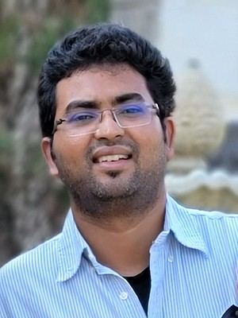
Praveen Sadineni, Technology Specialist (Salesforce, Integrations)
Professional Summary
Technology leader with over 13+ years of experience in the Salesforce Ecosystem.
Experienced in spearheading end-to-end technical programs and thrives on bridging the gap between business needs and technical solutions.
Expertise spanning across diverse industry domains, including Retail, High-Tech and Public Sector.
Successfully built, and nurtured high-performing teams dedicated to achieving shared business objectives.
Highly Experienced in event driven architecture in building scalable enterprise level applications.
Hands on experience with LWC components, Apex classes, triggers, Visual flows and configuration-based development.
praveen.sadineni@brillio.com
Austin,TX
Industry Experience:
High-Tech, Retail
Core Skill Sets
Experienced in building Scalable Enterprise Solutions on Force.com platform.
Extensive experience with Analysis, Design, Development, Customization, and Implementation of CRM Applications.
Experienced in working across various SFDC implementations covering Sales, Service, Marketing, Automotive Clouds.
In Depth Experience in Conga and Salesforce CPQ.
Project Experience
Ciena / Blue Planet: Vulnerability Tracking tool, Service Cloud, CPQ Implementation.
Public Facing Vulnerability Application with versioning ,sensitive data implications. Migrate from In house Entitlement tracker to Service Cloud Entitlements. CPQ Implementation with complex product and pricing structure.
Designed to Leverage Lightning Knowledge, OTB Entitlement with additional customizations. Salesforce CPQ with Pricing Integrations and OTB Product Rules.
Improved Case turnaround time, 2x improvement in Quoting efficiency. Faster vulnerability tracking and customer notifications.
Box Inc: CPQ Implementation, ORG Optimization.
CPQ Implementation with Complex Product Bundle Structure and Related Pricing Requirements. Renewal Redesign and Online Sales Re-architecture.
Challenges around complex pricing model, large Quotes, completely custom renewal requirements.
Reduced Pricing time by half. Ability to handle complex renewal scenarios.
Certifications
Salesforce Certified CPQ Specialist
Salesforce Certified Platform Developer
Salesforce Certified Data Cloud Consultant
Salesforce Certified AI Associate
Recent Roles
Salesforce Technical Architect
Salesforce CPQ Architect.
Salesforce Lead Developer.
Key Clients
Ciena
Box
Lexmark
Draiver
State of Kentucky
Schneider Electric

Slide 6
Praveen Sadineni, Technology Specialist (Salesforce, Integrations)
Draiver: Integration Framework, Handling Vehicle Telemetric data, POC’s on Heroku , Salesforce platforms
Migrate Various Compute Intensive applications which consume lot of Salesforce Platform Limits to Heroku platform. Needed Robust Messaging Integration.
Performed various POC’s to migrate some high process intensive apps to Heroku Platform. Provided Enterprise Level Messaging capability through Heroku and Firebase. Integrations to parse high complex telemetric data and document API’s on Swagger Hub.
Performance Improvements, Reduce Limit related Errors.
State of Kentucky: Citizen Portals, Workforce Portals, Multi ORG Strategy.
Challenges with Multiple ORG’s. Security and Compliance requirements for various citizen facing portals.
Established overall best practices for Salesforce Platform Across All State of Kentucky Org’s.
Promoted Component based development and event driven architecture and code sharing between multiple orgs.
2x Improvement in Development time with vast array of reusable components. Improved Compliance with State and federal regulations.
Schneider Electric: Custom CPQ Implementation on Force.com platform.
Develop a Custom Scalable CPQ Solution that can Integrate with Azure based Product Configurator. Implement configurable Product, pricing rules from scratch.
Involved in Architecture, Design and Development. Delivered Scalable Solution entirely on Force.com within limitations of the platform.
Managed team of 30+ Developers and standardized development practices and established development and deployment pipelines.
Lexmark / Perceptive Software: Sales , Service cloud implementation.
Handle Acquisitions and ORG Merges. Reduce Partner Portal License costs, High Volume Data Migrations. Sales and Service Cloud Implementation.
Implemented Partner Sharing Framework on Customer Portal for License Cost Reduction. Introduced DbAmp to establish data load pipelines and reusable scripts.

Slide 7
#2 Practitioners for Bankruptcy Mgmt App

Slide 8
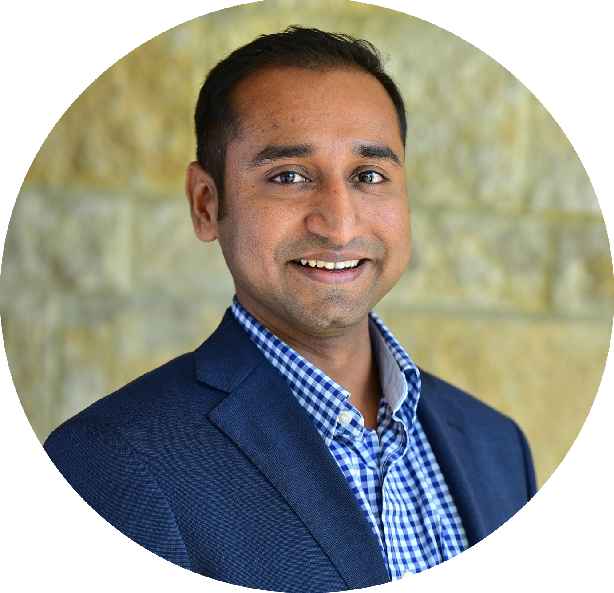
Aditya Ghadigaonkar, Salesforce Solutions Architect
Professional Summary
13+ years of consulting experience in Salesforce and ecosystem with 20 + end to end implementations.
Extensive experience implementation B2B and B2C solutions for High-tech, BFSI, Healthcare industry domains.
SME for PRM and Channel Ops management
aditya.g1@brillio.com
Dallas, TX
Industry Experience:
High-Tech, BFSI, Health Care
Relevant Project Experience
Ivanti: CPQ enablement for Partner
Experience cloud implementation with integration to multiple tools to give partners a holistic view of their pipeline, quotes and orders. Complex product and pricing structure to cater partner products and quoting journey
Reduced Admin task by more than 40%
Improved deal registration and quoting experienced and closer of deal by 3x.
Aligned the design to follow the OOTB approach for complex product structure needs.
Automated admin activities to streamline the process and auto trigger business approvals with minimum human interventions.
Nokia : Partner Portal and Market place implementation
Outdated partner portal was resulting in low partner engagement and limited capabilities. Partner Sales Manager’s 25% time spent on administrative task. High turn-around-time in maintenance due to customization in Salesforce. Lack of Partner locator site resulting in low deal registration and low visibility to customers looking for partners
Implemented partner portal with latest UI designs to match Nokia branding. Introduced intuitive UX designs and Journey builder as a guided path and learning for using the new tool. Which increased the user adoption and engagement by 40%.
Implemented Partner locator / Marketplace to match potential customers with partners. Increased deal registration by 30%
Core Skill Sets
Extensive experience in delivering digital transformation implementation for Salesforce platform and eco-systems
Experienced in delivering Sales, Service, Experience, Financial Service cloud implementation for B2B and B2C solutions Expertise with PRM and Channel Management solutions
Extensive experience with conducting in-depth workshops for Analysis and Design
Certifications
Salesforce Certified Application Architect
Salesforce Data Architecture and Management Designer
Salesforce Sharing And Visibility Designer
Salesforce Certified Community Cloud Consultant
Salesforce Certified Advanced Administrator Salesforce Certified Service Cloud Consultant
Salesforce Certified Sales Cloud Consultant
Recent Roles
Solution Architect
Salesforce Technical Architect
Impartner Architect and Solutions Lead
Key Clients
Nokia
Pulse Secure
Bloom Energy
Ivanti
TiVo
Twitch
Extreme Networks
Dayforce

Slide 9
Aditya Ghadigaonkar, Salesforce Solutions Architect
Extreme Networks : Lightning Transformation and Sales Process improvement
Salesforce classic to lightning transformation for the entire org 10K + users.
Extreme Networks was facing challenges with heavy customization on the existing application and lightning readiness with third-party applications.
Performed consolidation of UI, profiles and redundancies to increase user experience and performance by ~20 %.
Performed replacement for apps and customization to align with the OOTB Salesforce capabilities for future proofing the org.
Led user adoption and training session for newly enabled UI.
Automated manual sales processes for internal as well as external approvals that increased the stakeholder engagement and transparency.
Pulse Secure : Deal Registration and Onboarding process automation
Onboarding was a custom implementation with an involvement of multiple teams with multiple systems to onboard distributors and re-sellers. Challenges were faced with high turn-around-time, lack of transparency and delays in onboarding.
Deal registration was a manual process performed by the Sales along in collaboration with the distributors.
Implemented Smart onboarding along with automated approvals and with integration to multiple systems for seamless experience and faster onboarding process.
Automated the deal registration process from excel to Salesforce Sales cloud and Experience cloud.
Performed fit-gap analysis to identify the right tool and applications to accommodate the needs through out of the box capabilities.

Slide 10
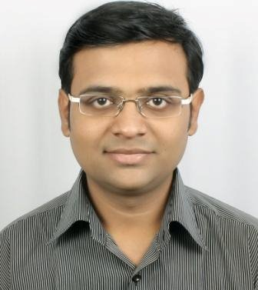
Rohit Joshi, Salesforce Technical Architect
Rohit.Joshi1@brillio.com
Pune, India
Industry Experience:
Finance, High-Tech, Retail, Healthcare, Logistics
Professional Summary
Salesforce Technical Architect with 10+ Years of IT experience with strong Object-Oriented Analysis, designing and programming skills on the Salesforce platform.
Strong knowledge of Force.com development best practices.
Technical leader with sound knowledge on Architecting the systems from scratch with data privacy, visibility etc.
Knowledge of data integration tools and experience integrating Salesforce with different business systems.
Scripting: JavaScript, jQuery.
Data Migration: Import-Export Wizard, Data Loader,
Deployment: Preparing Checklists, Change Sets and Uploading them to different sandboxes, Release management, branching, CI/CD with Jenkins, Code Merge etc
Core Skill Sets
Technical Architecture, proficiency in building scalable & reusable enterprise solutions
Technical leader with proven experience of Analyzing, Designing, Implementing, Developing and Customizing Enterprise applications
Proficiency in large data handlings, archival strategies , external objects, big objects
Vast implementation experience in Sales, Service, CPQ
Implemented Solutions for various business domains including Financial Services, Manufacturing, Retail, Life Science, Manufacturing.
Relevant Project Experience
Toast: Qualtrics End-to-End design and implementation • CDP [Customer Data Portal] implementation
Survey tool implementation end to end, without impact on existing sales/ service process
Removed big technical chunks of the existing architecture and refactored it to improve sales/ service call times, worked on LWC, Apex and Flow refactoring along with scratch implementation.
600% increase I data capture,43% revenue increase in the upcoming quarter post implementation
100 % error drops in existing process of preparing
3 sec time drop in preparing agreement process, increase in Rep / Executive productivity by 28%
Increase in converted Lead Shares / Service Requests, increased conversion of Closed deals into Win Deals.
Certifications
Salesforce Certified Application Architect
Salesforce Certified Sharing and Visibility Architect
Salesforce Certified Data Architect
Salesforce Certified AI Associate
Salesforce Certified Data Cloud Consultant
Salesforce Certified Platform Developer – I & II
Salesforce Certified Platform App Builder
Salesforce Certified System Administrator
Recent Roles
Technical Architect, Application Architect
Key Clients
Currencies Direct
Move.com
Blue Dart
Shell
Toast

Slide 11
Rohit Joshi, Salesforce Technical Architect
Shell: Sales and Service cloud implementation for Researching of Oil and Gas mechanisms
26% increase in research tooling capabilities in a quarter overall, making product enablement decisions easy
Improved collaboration between different research teams, facilitating easy shared data availability
Improved stage gate assessments and collaboration for different research stages of the projects
Departmental revenue increased by 37% in a quarter which continued to be improved and went to 67% at the end of the financial year.
Data leakage issues dropped to 0 % due to strict implementation
Bluedart : Implementing custom requirements for Sales, Service, Inventory and Pricing departments
Improved 3x Lead conversion rate, 28% improvement in case resolution for end users
Case management and case cycle refactored to notice 3 mins positive decrease in resolution time
Built pricing implementation in collaborated integration with SAP and legacy system. Noted improvement of correct calculations as per courier weights and improved revenue by 33.8% in 2 quarters post implementations and helped organization recover loss from previous erroneous calculations.
Dealt with real time integration challenges with SAP in terms of high volume of API calls. Refactored SAP integration which in turn improved data availability in greater extent and helped maintaining org health optimal
Resolved challenges on courier types, material included, and bulk ordering discounts for big organization and mad the process smoother than earlier to help Sales Reps / Service Executives
Built logistics model for Bluedart which is dynamic, scalable and ready to accept future changes by using customization with Apex (Synchronous and Asynchronous) , LWC, Lightning Flows and out of the box salesforce features.

Slide 12
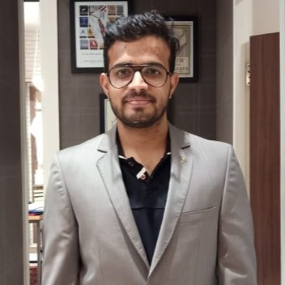
Rahul Patil, Senior Development Lead
Professional Summary:
Salesforce Technical Lead with 8+ years of hands-on experience in Salesforce implementation, customization, and support.
Collaborated with stakeholders to gather requirements, analyze business processes, and design scalable solutions tailored to client needs.
Skilled in direct client interaction, requirement gathering, and solution demonstrations.
Proficient in complex customizations, configurations, and enhancements. .
Managed team with 4-5 members, ensuring seamless delivery.
Extensive knowledge of Lightning Migration Projects with a good understanding of migrating VF pages, JS buttons, building consoles, and knowledge Migration.
Proficient in Salesforce Technologies like LWC Framework, Apex (Synchronous and Asynchronous)
rahul.patil@brillio.com
Bengaluru, India
Industry Experience:
Insurance , MedTech and Telecommunication
Core Skill Sets
Requirement Gathering, Solution Design and Implementation.
Expertise in developing solutions for Insurance, Telecommunication, MedTech industries.
Proficient in developing LWC, Aura, Apex, Flows, and other Salesforce standard features.
Relevant Project Experience
iRhythm Inc – Managed Services - Lightning Migration .- Sales and Service Cloud Implementation
Entire Salesforce Instance was on Classic with lots of technical debt. Migrated the Entire Instance from salesforce classic to lightning.
Understanding and analyzing the Business Requirements and working with the client to understand their current business issues and pain points.
Assessment of client systems and identifying the desired To-Be process models and solution architecture that will address the issues.
Leading a team of 4 members and ensuring a seamless flow of project deliverables by doing code reviews, brainstorming on challenging tasks, and providing necessary knowledge.
Migration resulted in 100% Lightning Adoption.
Usage of lightning knowledge articles to resolve the cases efficiently.
Agent Productivity Increased 2x after implementing lightning service console providing them with 360 degree of customer information.
Manual Intervention reduced almost to zero by implementing service cloud case routing and assignment features.
Certifications:
Salesforce Data Architect
Salesforce Platform Developer 2
Salesforce JavaScript Developer 1
Salesforce Platform Developer 1
Salesforce Accredited Health Cloud Professional
Salesforce Field Service Consultant
Salesforce Service Cloud Consultant
Salesforce Experience Cloud Consultant
Salesforce Platform App Builder
Salesforce Admin
Recent Roles
Technical Architect, Application Architect
Key Clients
iRhythm
Sprinklr
Lexmark

Slide 13
Rahul Patil, Senior Development Lead
Sprinklr: App Exchange Product Development and Security Review
Responsible for App listing and Security Review planning.
Implemented Code changes to make app code salesforce app exchange security complaint.
Scanning the app using Checkmarx scanner and make necessary adjustments in the app to make it security complaint.
Post Successful security review by Salesforce the app was hosted in the App exchange resulting in improved revenues for Sprinklr.
Allstate : New Agency Onboarding - Sales and Experience Cloud Implementation
Inefficient use of Salesforce to onboard new agencies resulting in 45 days to onboard new agencies.
Development of new Agency Onboarding process using Vlocity Managed App and Sales Cloud..
Worked extensively on Omniscripts and Data raptors as an alternate to Aura/LWC using Vlocity application..
Implemented Partner Community Portal from scratch for the agencies.
This implementation reduced Onboarding of an agents to 72 hours from 45 days.
Completely paperless onboarding process after integration with DocuSign avoiding mistakes resulting in delayed onboarding.
Capgemini: Managed Services
Analysis of functional Specifications received from the client.
Implemented Apex Classes & Triggers for complex automation requirements.
Designing & providing optimal solutions
Designing Test Case Documents and involved in Functional and Unit Testing.
Worked as a standby support agent during on call hours.

Slide 14
Thank You Let’s create something amazing together

